Slide 1

PD313- Hotel Rating Classification
Group 3

Slide 2
P313- Hotel Rating Classification
Objective:
Examine how travellers are communicating their positive and negative experiences in online platforms for staying in a specific hotel
The attributes that travellers are considering while selecting a hotel
Inputs Provided:
Sample dataset which consists of 20,000reviews and ratings for different hotels
Understanding the Terminology in Data:
Review-Textual reviews with punctuations , numbers.
Rating – Rating weightages given as 5 = Excellent & 1 = worst
There is also @ column in data set which does not contain any information

Slide 3
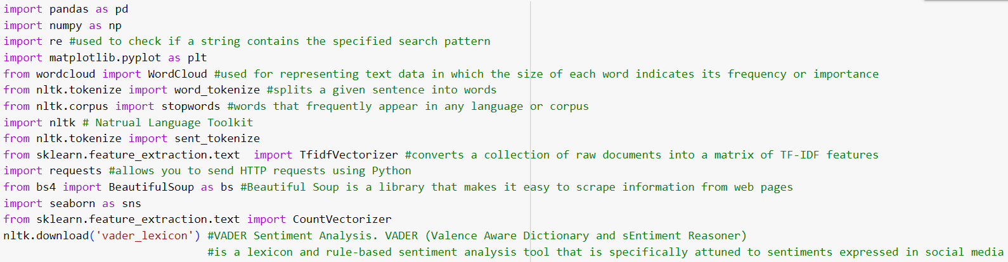
Importing Required Libraries:

Slide 4
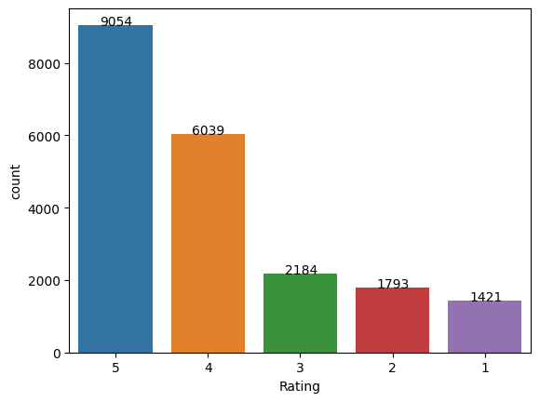
EDA for prepare data for predictive modelling:
Understanding the data structure
- Shape of data Rows: (20491, 3)
Distribution of Reviews w.r.t Rating

Slide 5
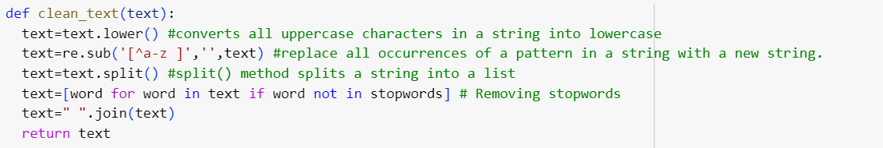
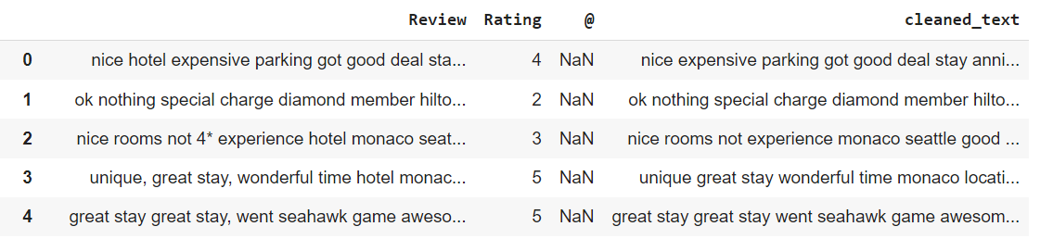
Cleaning Data:
Cleaning the data for better model building by-
Creating new column of Review with clean text by
Converting text into lower case
Removing punctuations and digits
Removing stop words

Slide 6
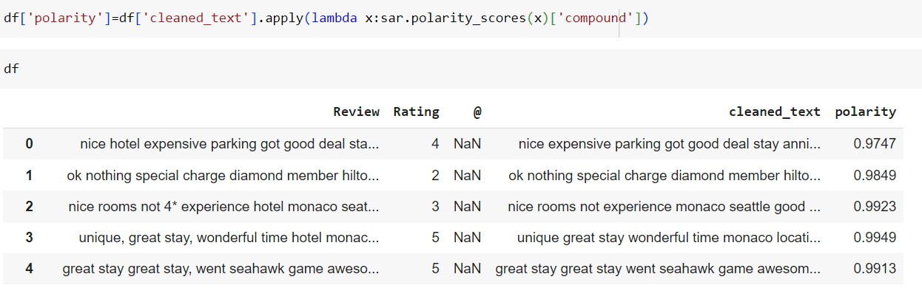
Calculating Polarity of Cleaned Text:
The overall sentiment conveyed by a particular text, phrase or word.
Polarity is expressed in numerical range from -1 to 1
-1 indicates extremely negative sentiment, +1 indicates extremely positive sentiment, and 0 indicates neutral sentiment.
The compound score is the sum of positive, negative & neutral scores which is then normalized between -1(most extreme negative) and +1 (most extreme positive).

Slide 7
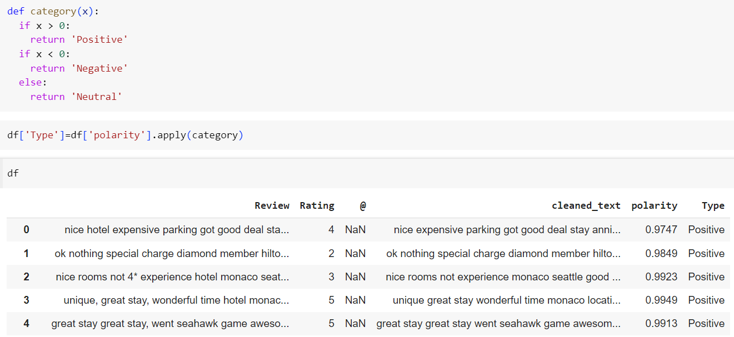
Defining Sentiment based on polarity:
If Polarity is > 0 Positive
Polarity is < 0 negative
Polarity is = 0 Neutral

Slide 8
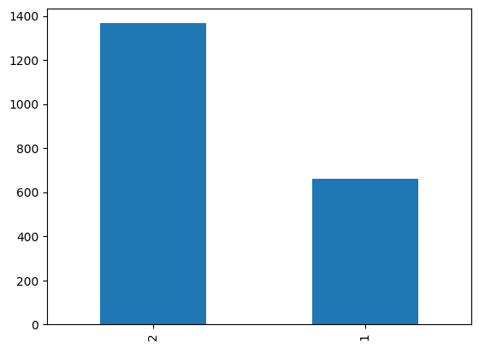
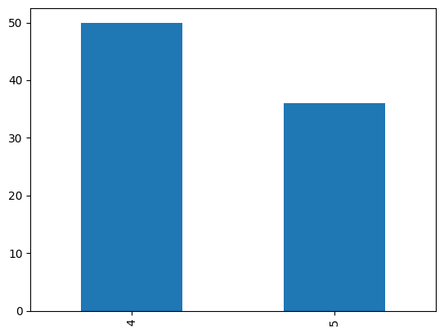
Observation on Review, Sentiment & Rating
There are Positive Comments rated 1 & 2 and vice versa
Positive Comments Graph
Negative Comments Graph

Slide 9
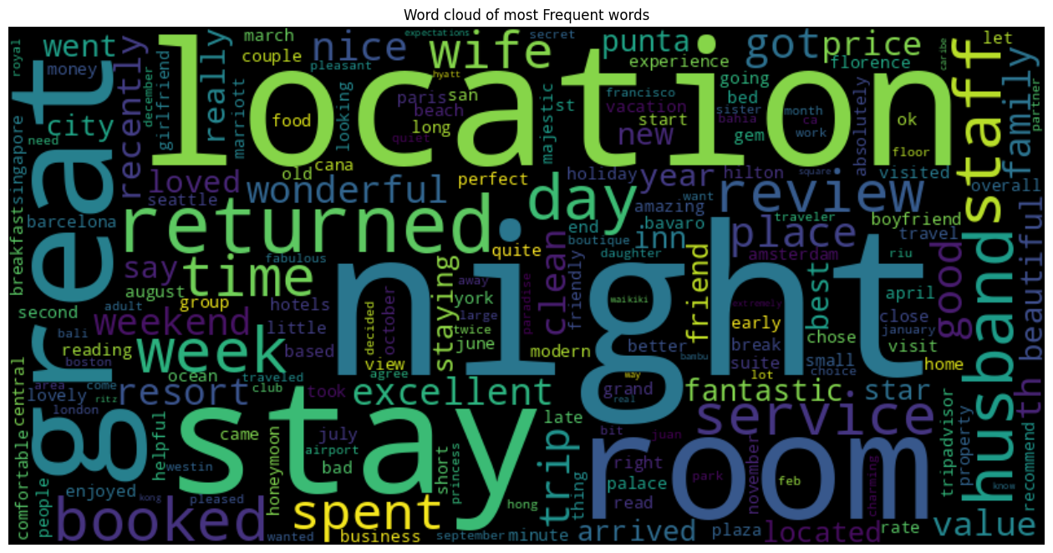
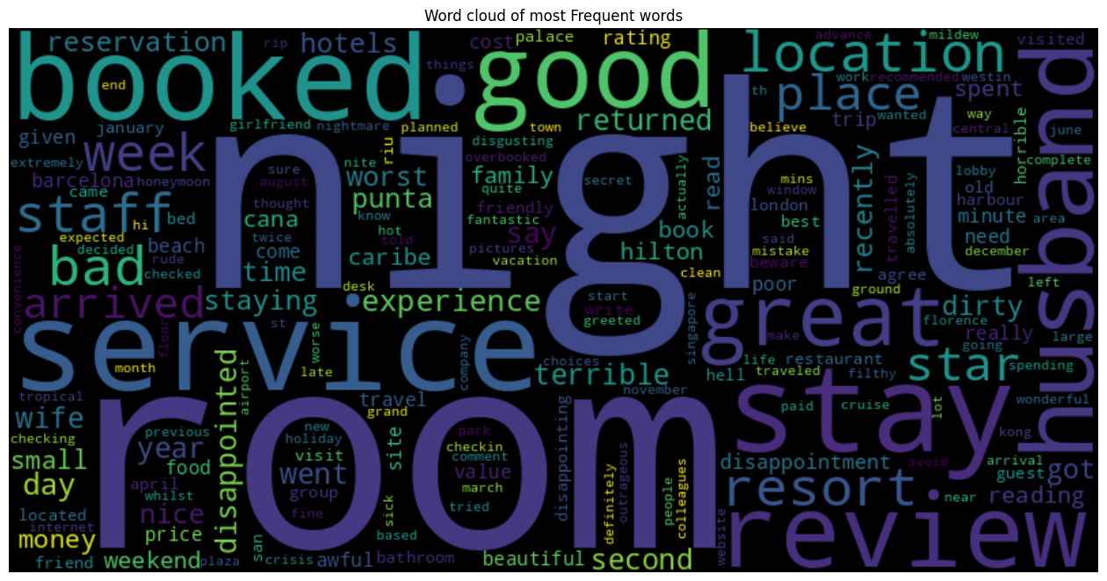
Observation on Word Cloud
Frequent word in Positive comments Location.
Frequent word in Negative Comments Room.
Positive Comments Word cloud
Negative Comments Word cloud

Slide 10
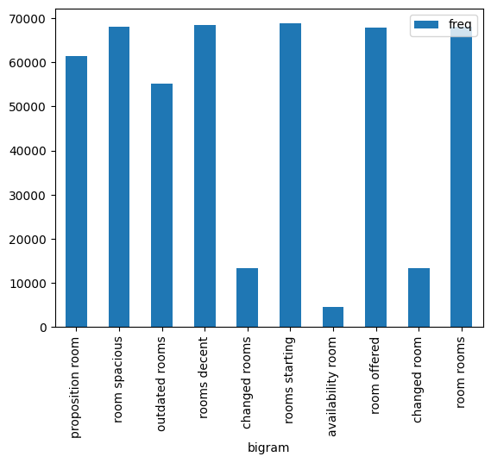
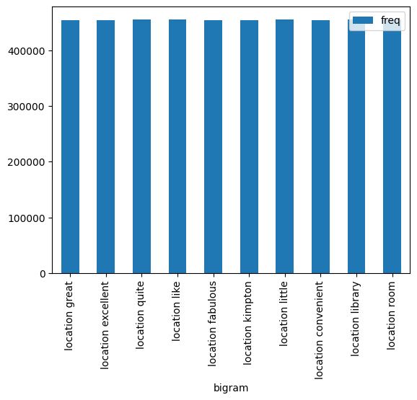
Further Analysis on Positive & Negative Attribute
Positive Comments Word cloud
Negative Comments Word cloud

Slide 11
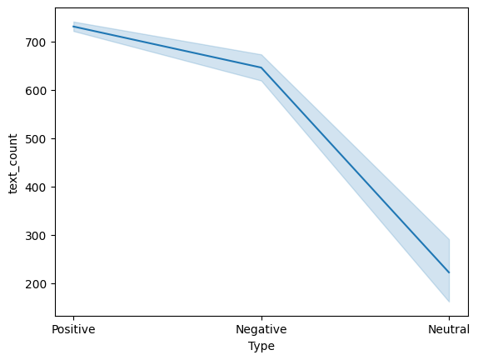
Observation on Length of Review and Sentiment
Length of Text is more for Positive Reviews than Negative Reviews.
Length of Text is count is lowest for Neutral reviews

Slide 12
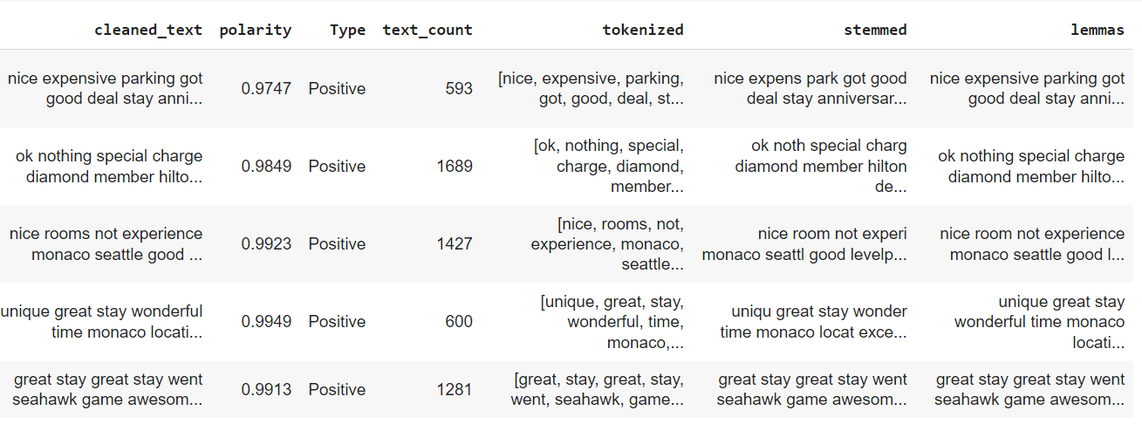
Tokenization
Lemmatization
Stemming

Slide 13
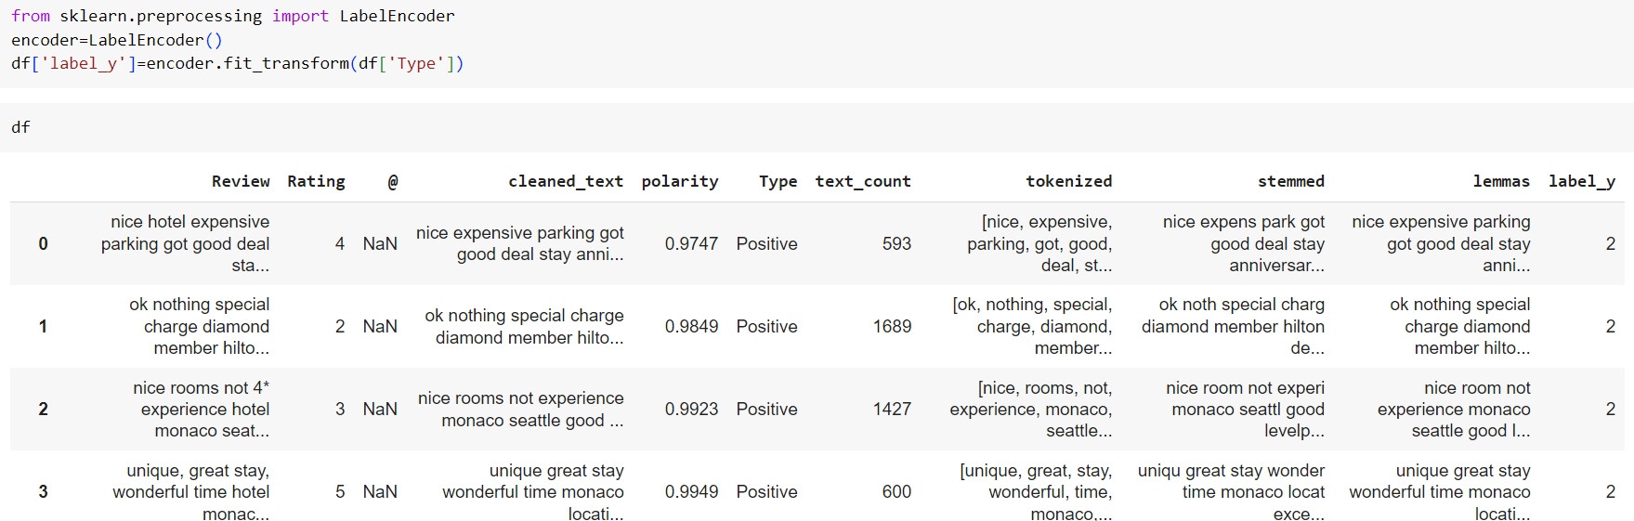
Converting Sentiment in Numbers by using Label Encoder
Positive=2
Neutral=1
Negative= 0

Slide 14
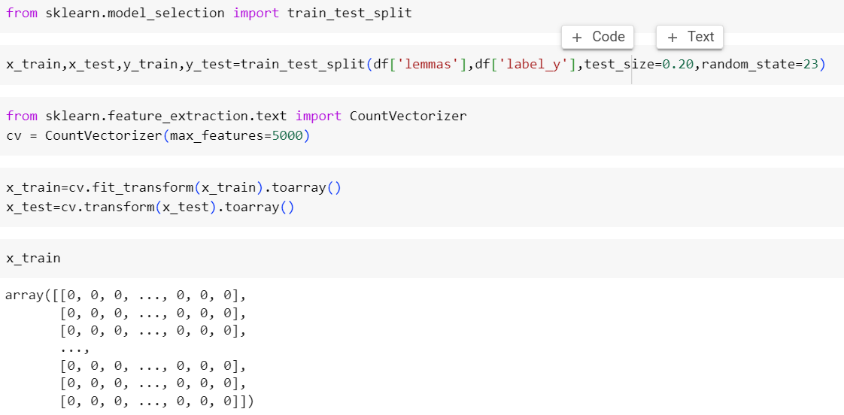
Splitting data into Test train & converting into numerical representation using Count Vectorizer

Slide 15
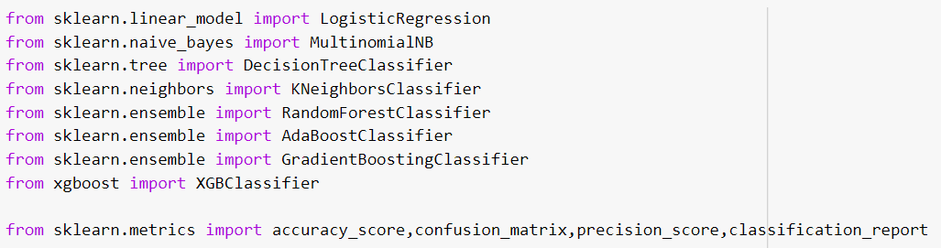
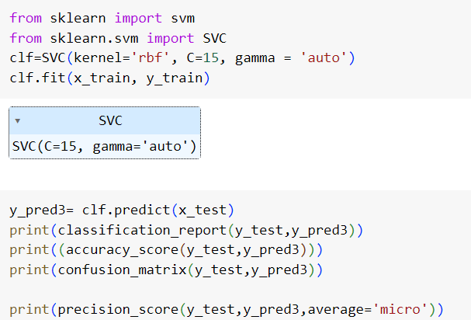
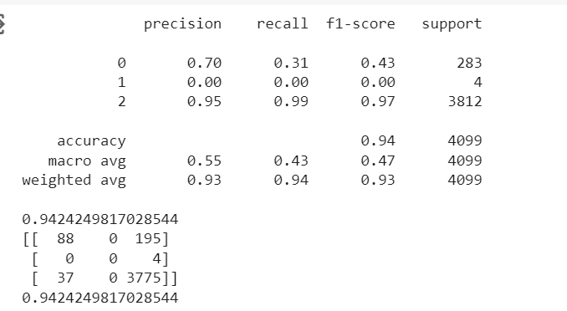
Building Models
SVM for example
Classification report

Slide 16
Accuracy Comparison
Model Name | F1 Score (neg=0) | F1 Score (neu=1) | F1 Score (pos=2) | accuracy
LogisticRegression | 0.61 | 0.00 | 0.97 | 0.95
MultinomialNB | 0.53 | 0.00 | 0.95 | 0.90
DecisionTreeClassifier | 0.37 | 0.00 | 0.95 | 0.91
KNeighbourClassifier | 0.34 | 0.00 | 0.95 | 0.91
RandomForestClassifier | 0.14 | 0.00 | 0.97 | 0.93
AdaBoostClassifier | 0.19 | 0.00 | 0.96 | 0.93
GradientBoostingClassifier |  | 0.00
XGBClassifier |  | 0.00

Slide 17
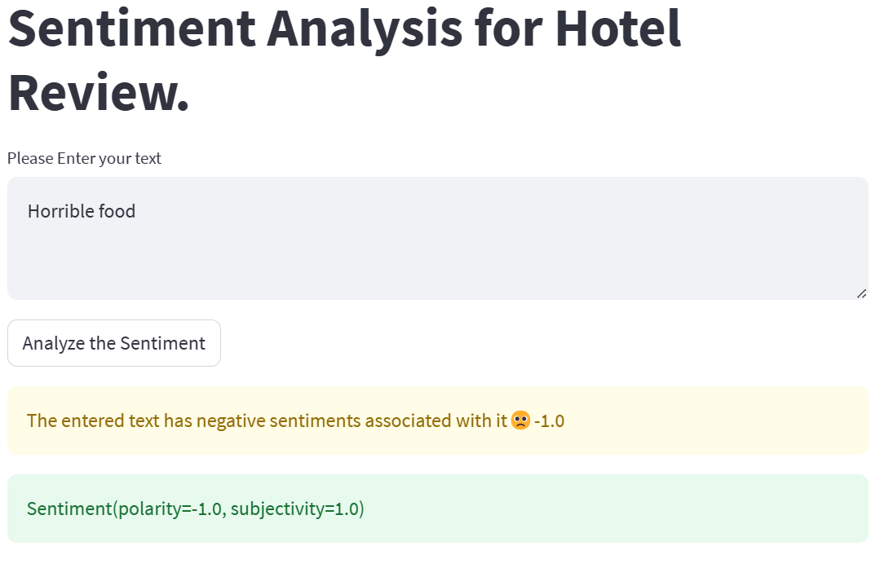
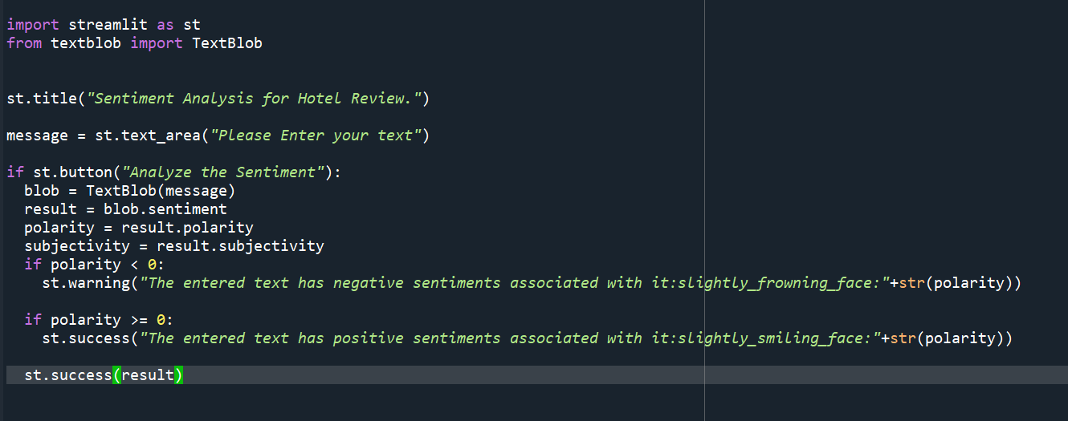
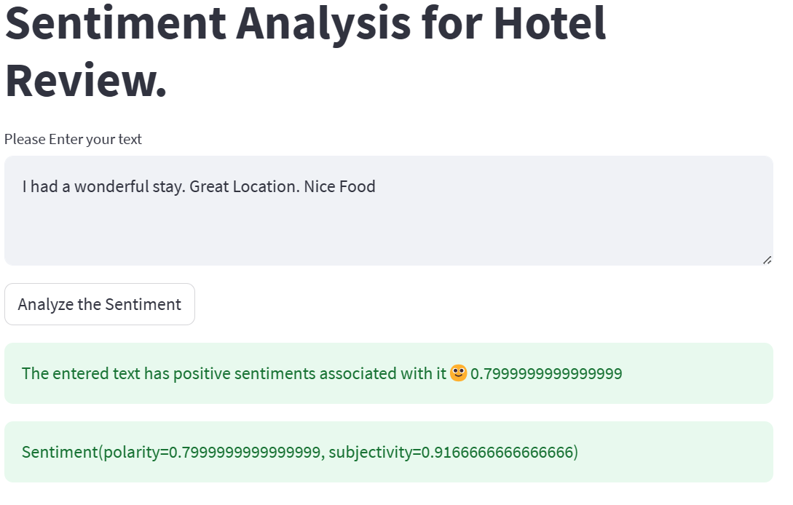
Deployment using Streamlit

Slide 18
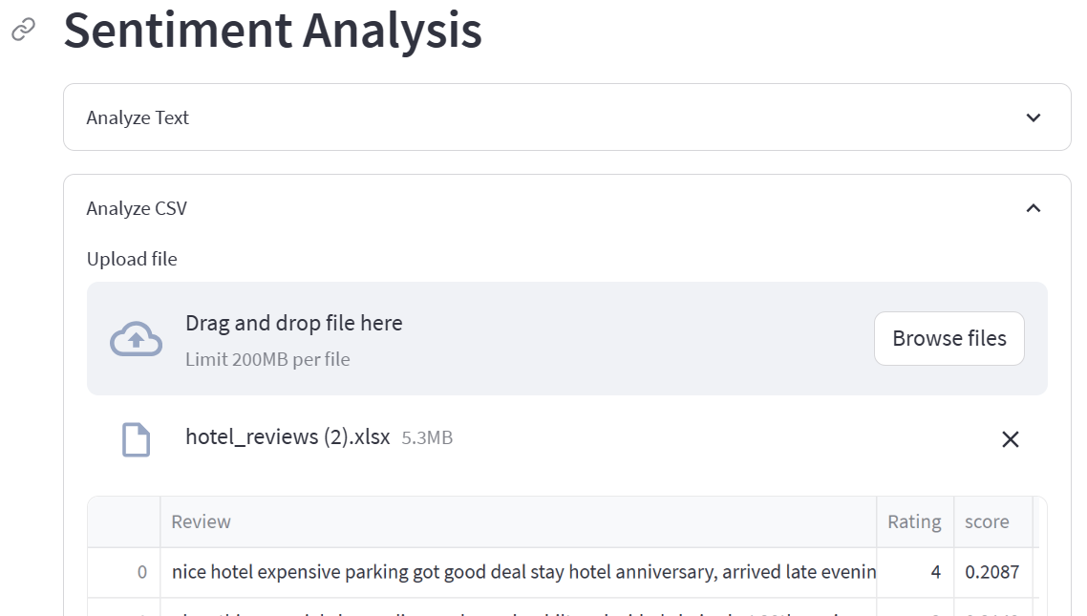
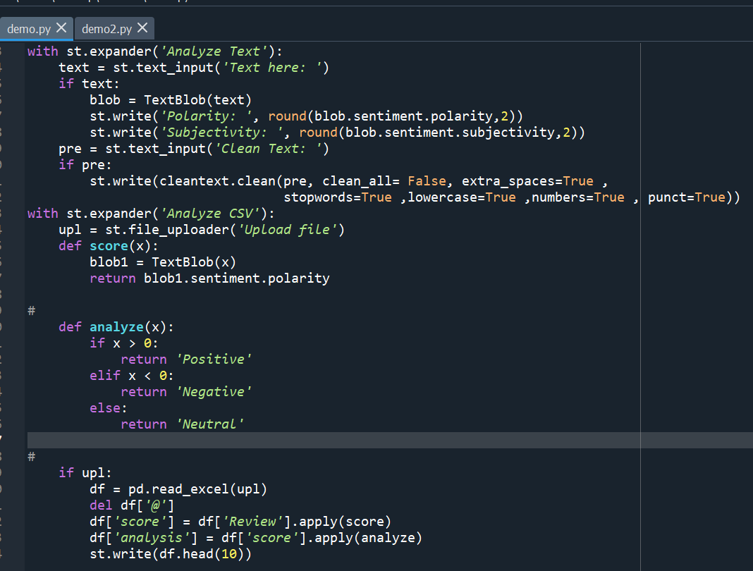
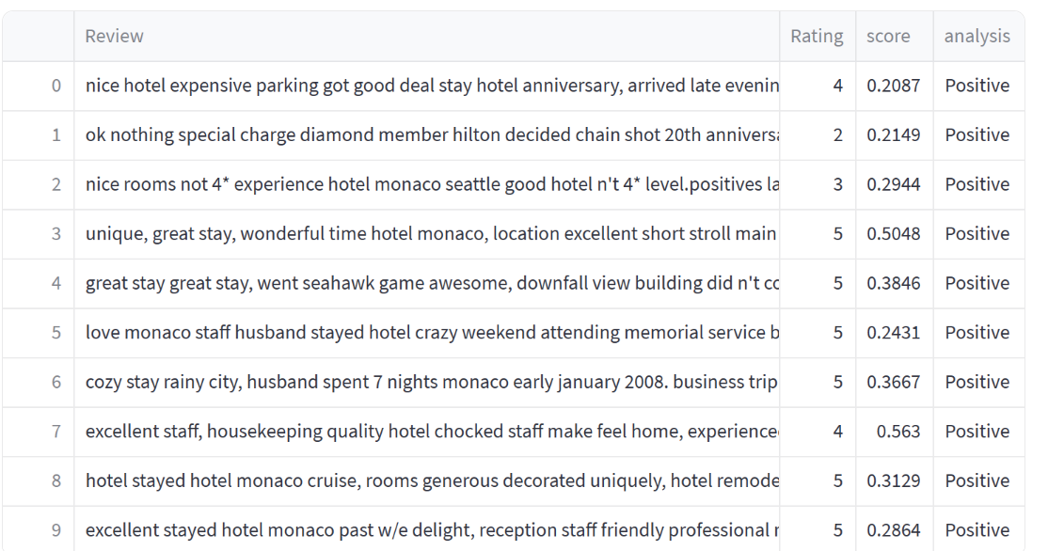
Deployment using Streamlit

Slide 19
Thank you

